Slide 1
Linear Regression &
Gradient Descent
ML Club Week 2

Slide 2

Discord Server!

Slide 3

GitHub!!!

Slide 4
Linear Regression - Overview
Supervised ML
Compute linear relationship: Dependent y - Predictor(s) x(s)
Simple linear regression: x (1 Predictor)
Multiple linear regression: xs (>= 2 Predictors)

Slide 5
Simple Linear Regression

Slide 6
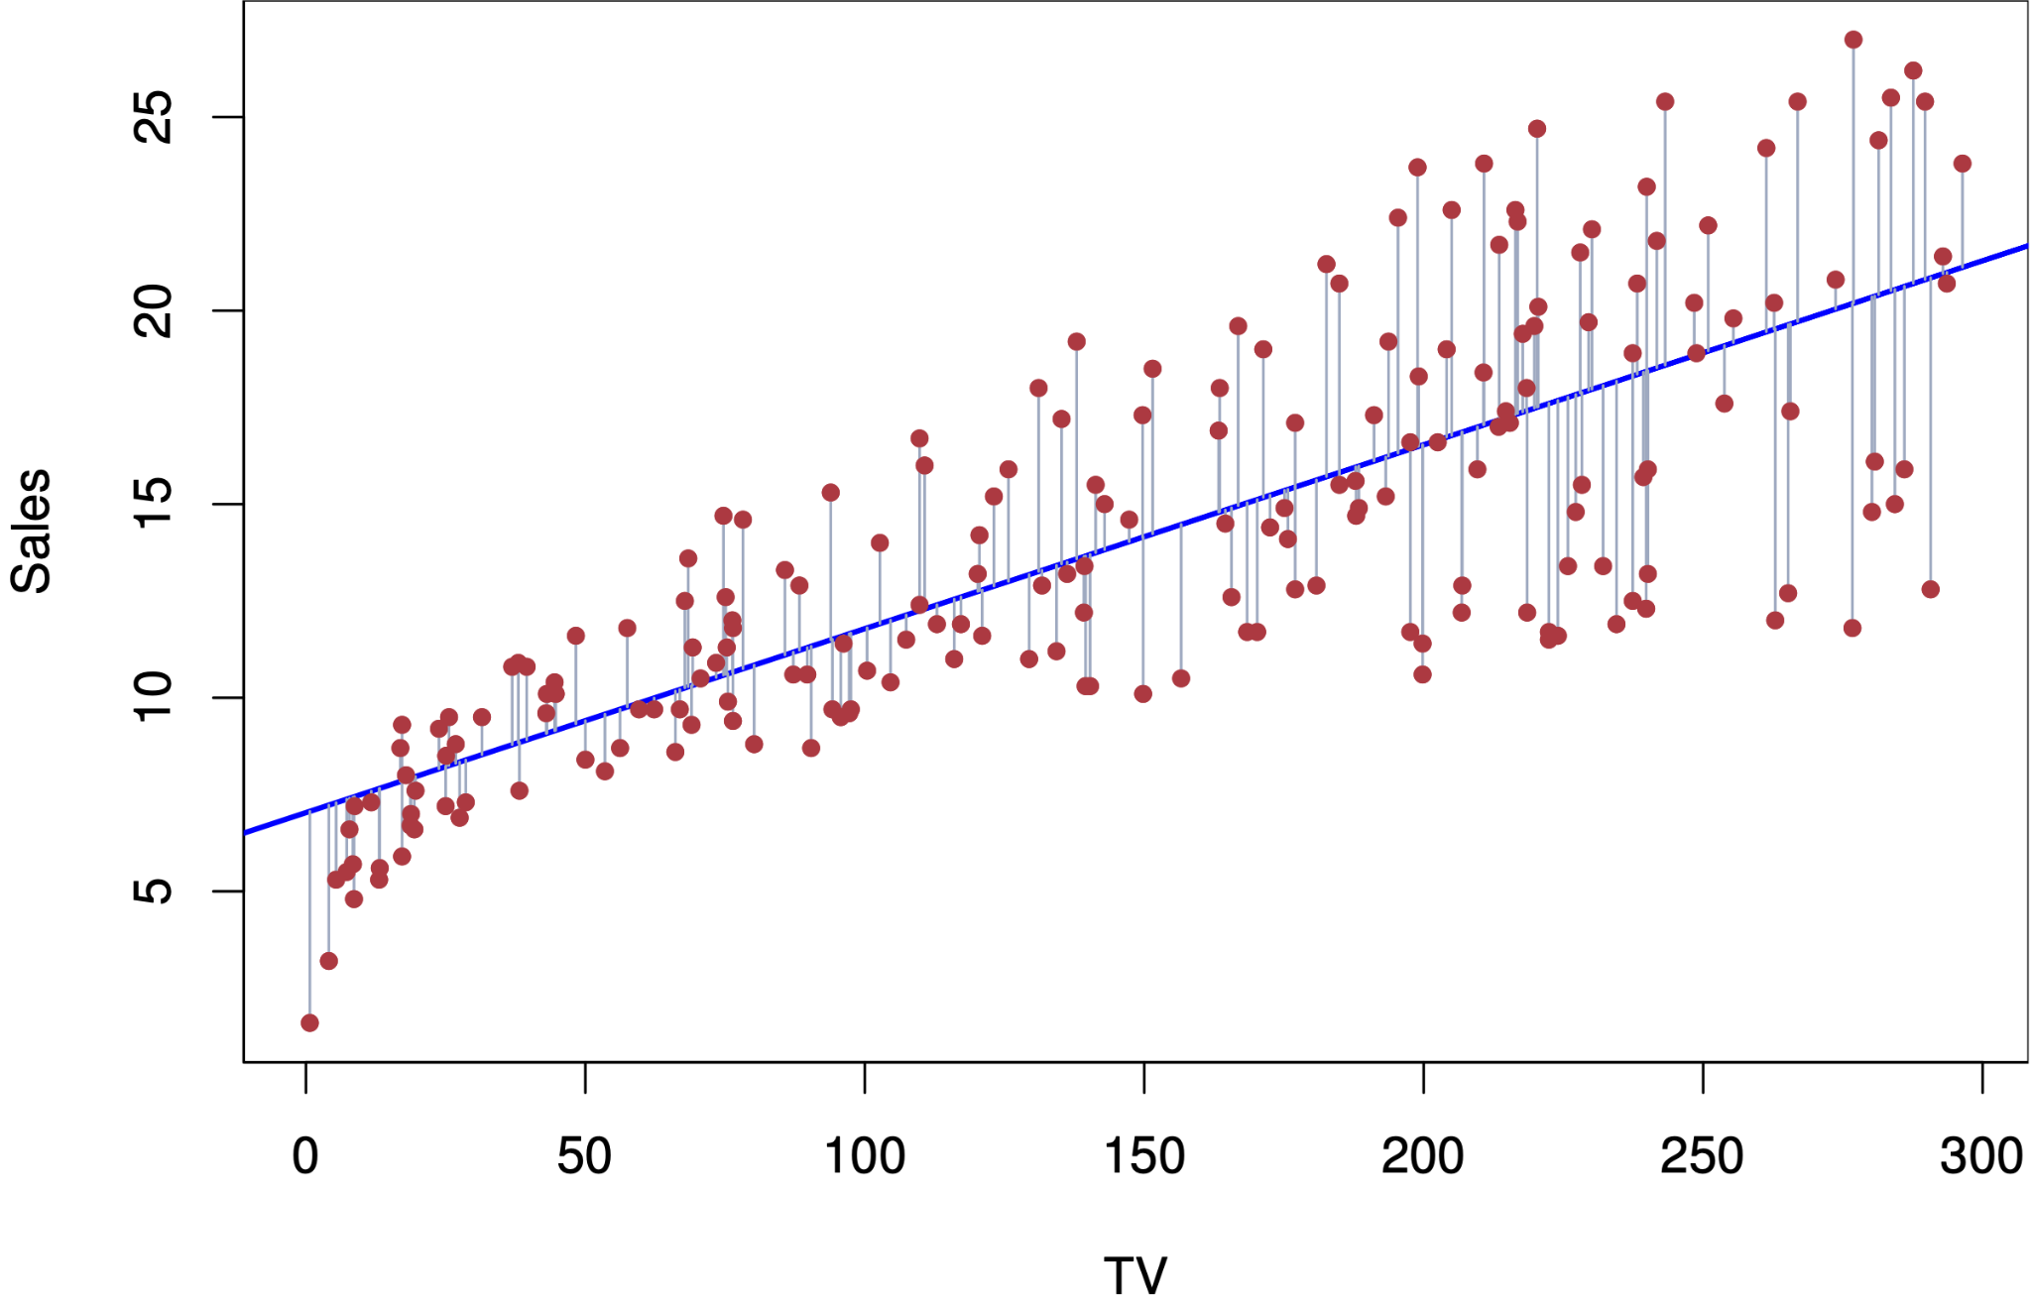
y = wx + b
output
weight
input
bias
(linear relationship between x and y)

Slide 7
Multiple Linear Regression

Slide 8
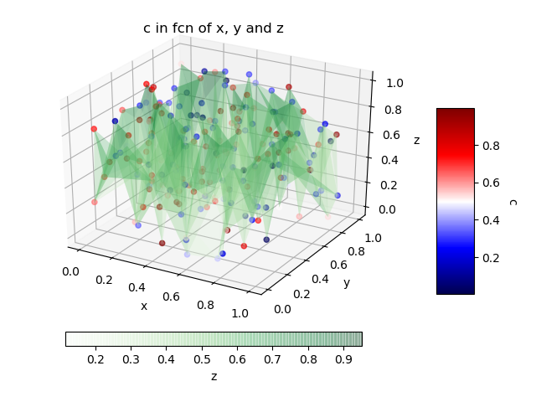
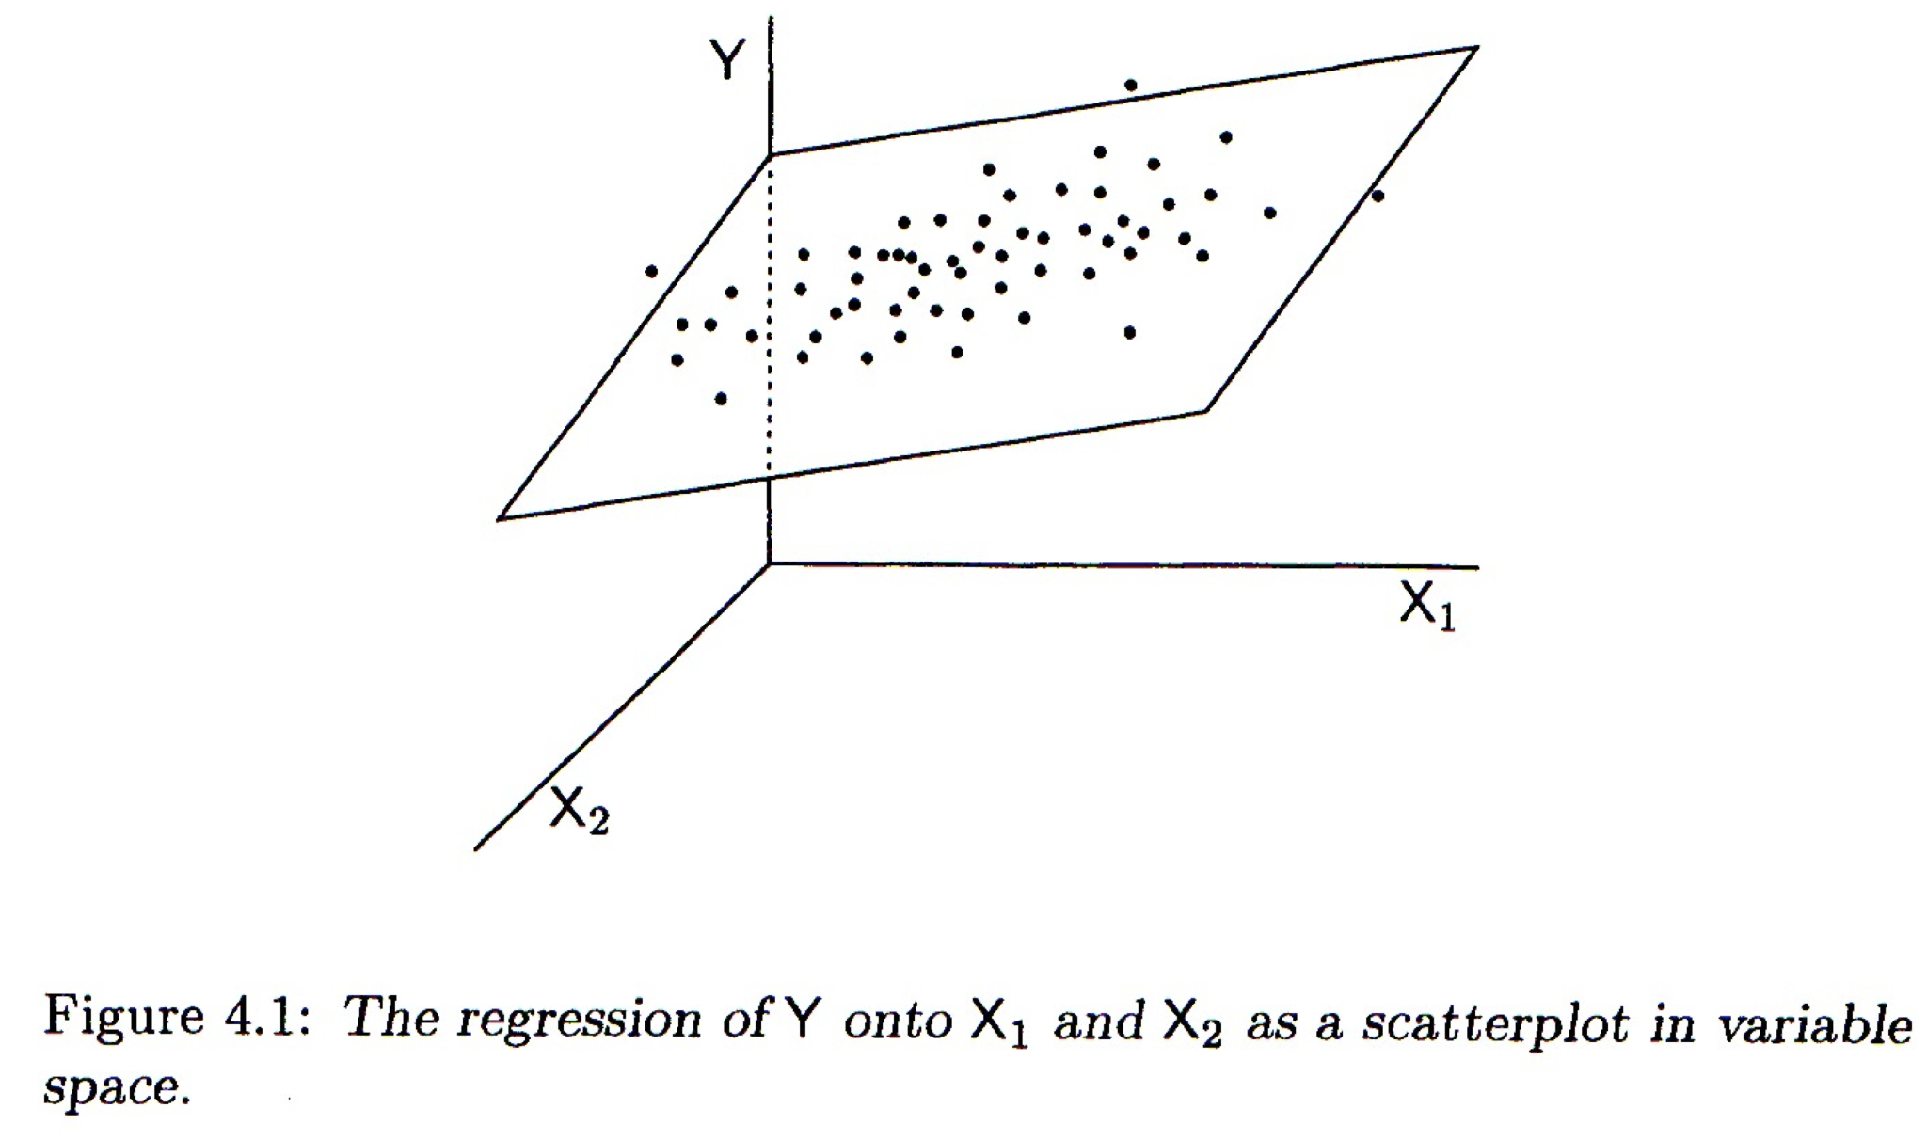
Multi features
2 variable (= feature)
more

Slide 9
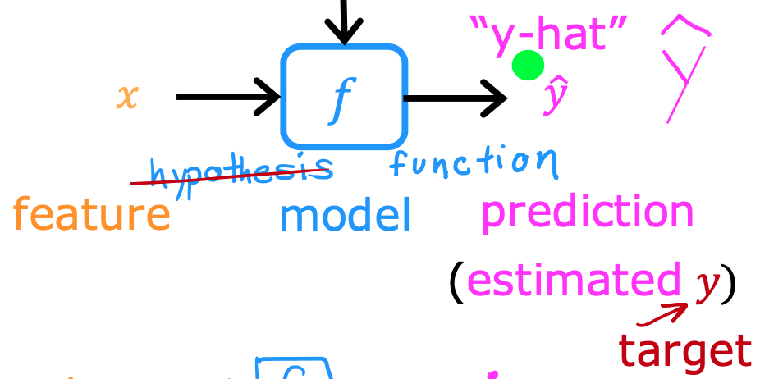
Regression

Slide 10
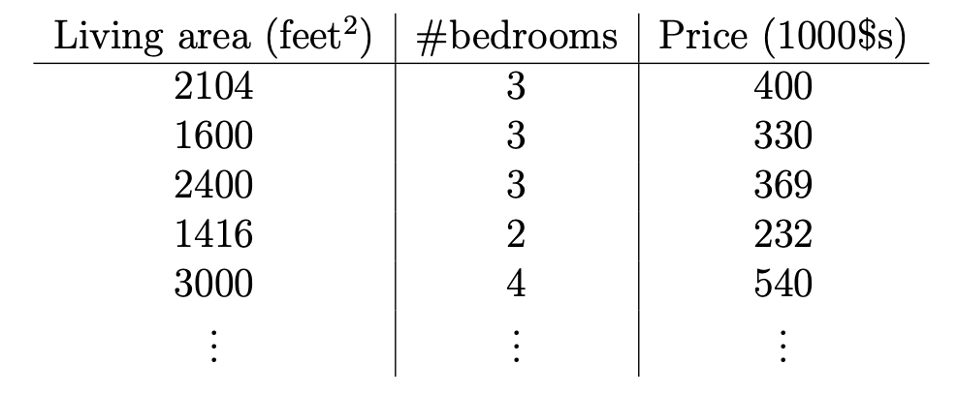
Dataset example
x₁ x₂ y

Slide 11
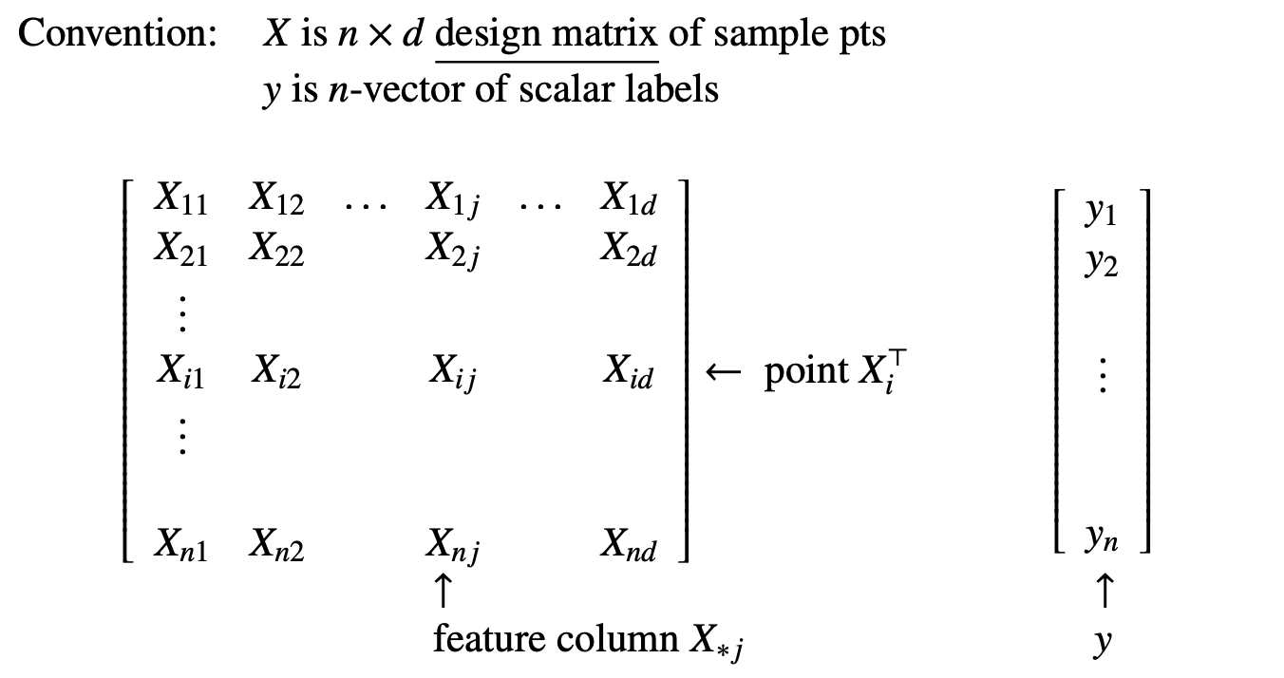
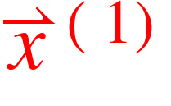

Slide 12
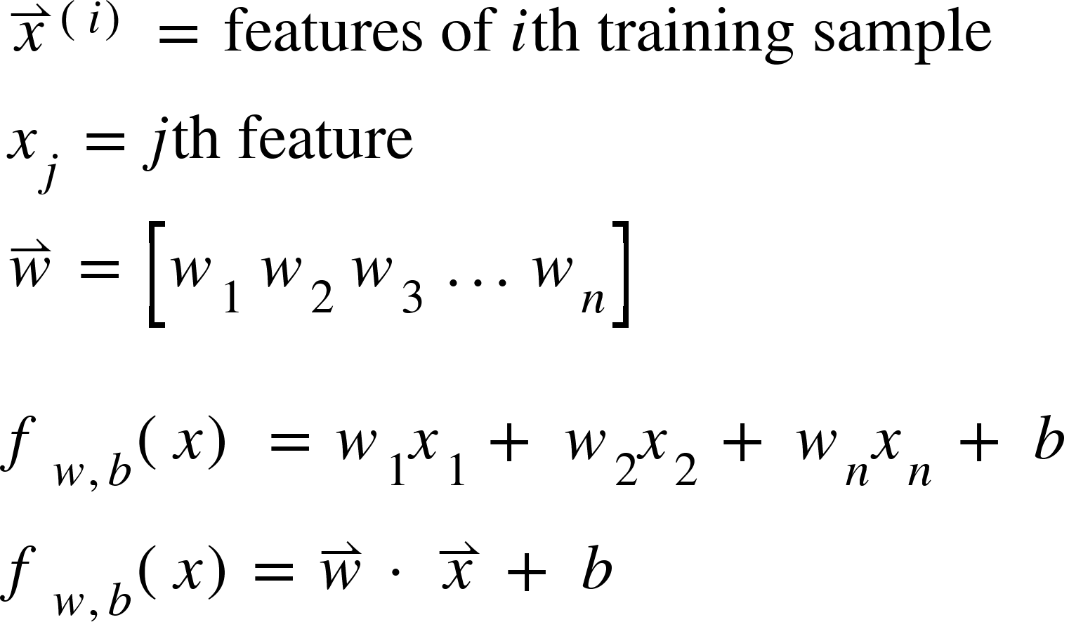
Notations
T

Slide 13
How to find the optimal w?
minimize the Cost!
high cost = discrepancy between y and ŷ
low cost = prediction is pretty accurate

Slide 14
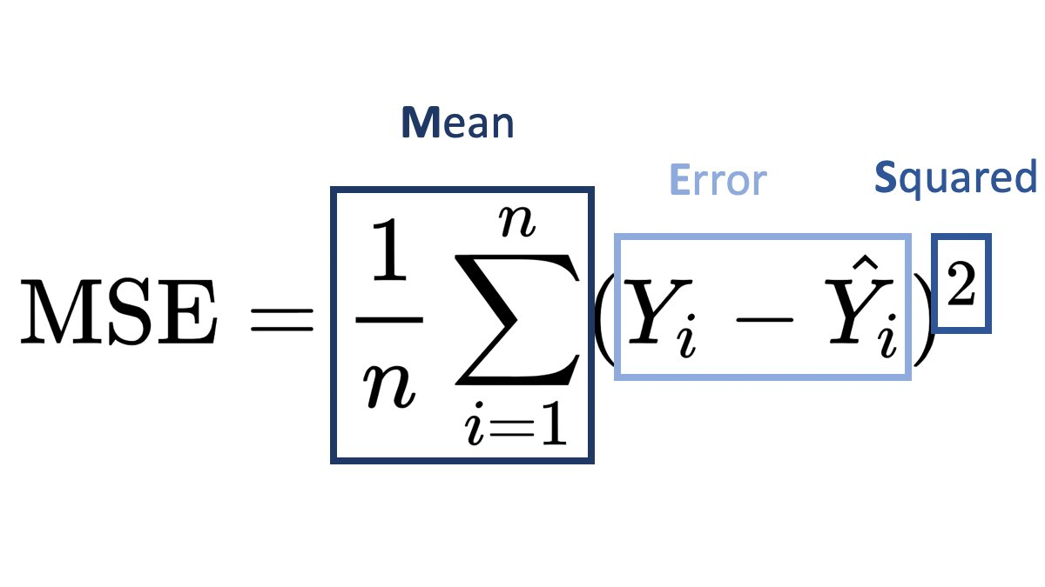
Parameters (w) & Cost Functions (Mean Squared Error)
MSE: Average of squared errors between predicted and actual values.
How close the model’s predictions are to observed values.
Goal: Estimate the optimal set of weights (w) that minimize cost (MSE).
J(w, b) =

Slide 15
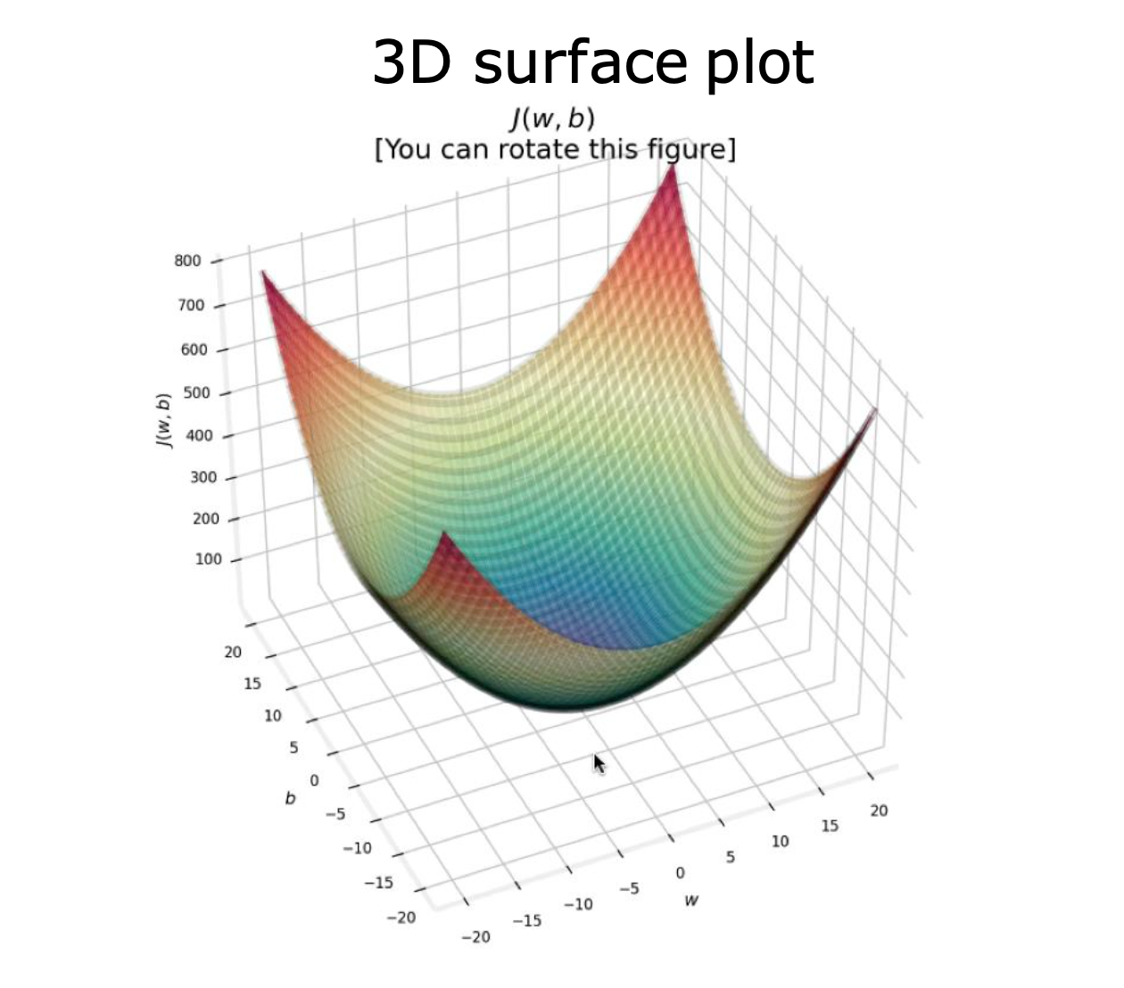
J(w, b) - one feature and one bias
MSE cost is always convex! (regardless of how many features)

Slide 16
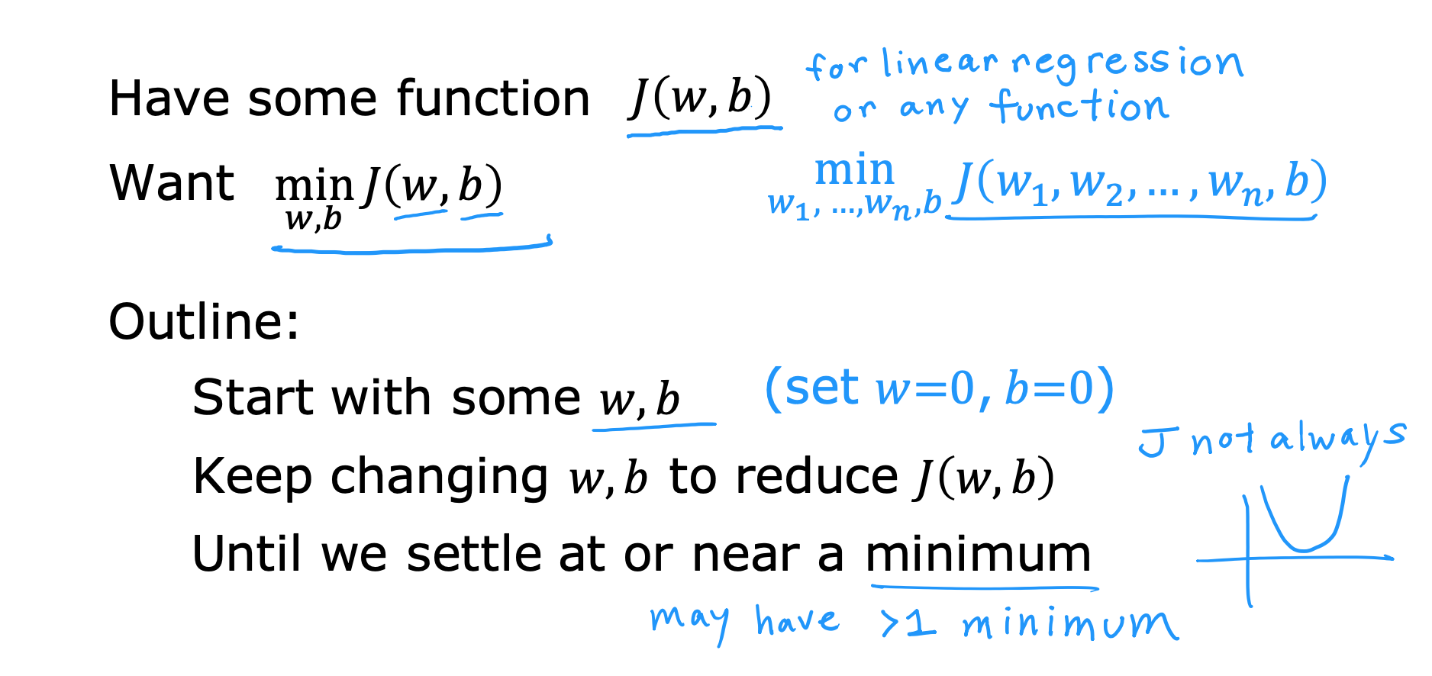
Gradient Descent

Slide 17
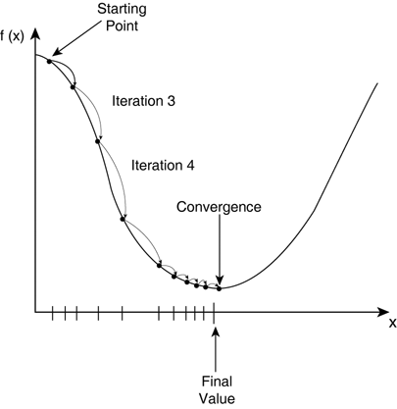
Gradient Descent in 2D

Slide 18
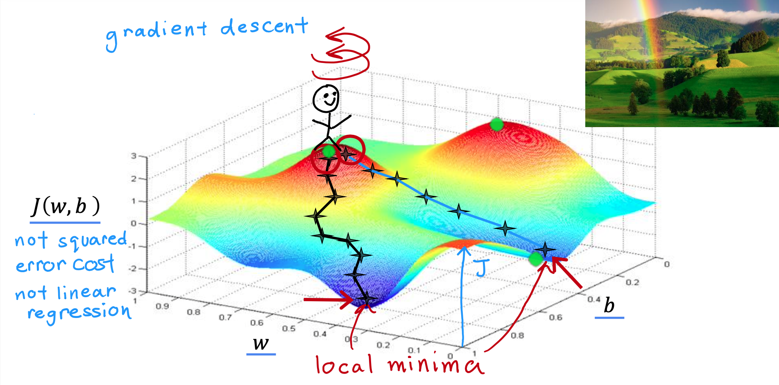

Slide 19
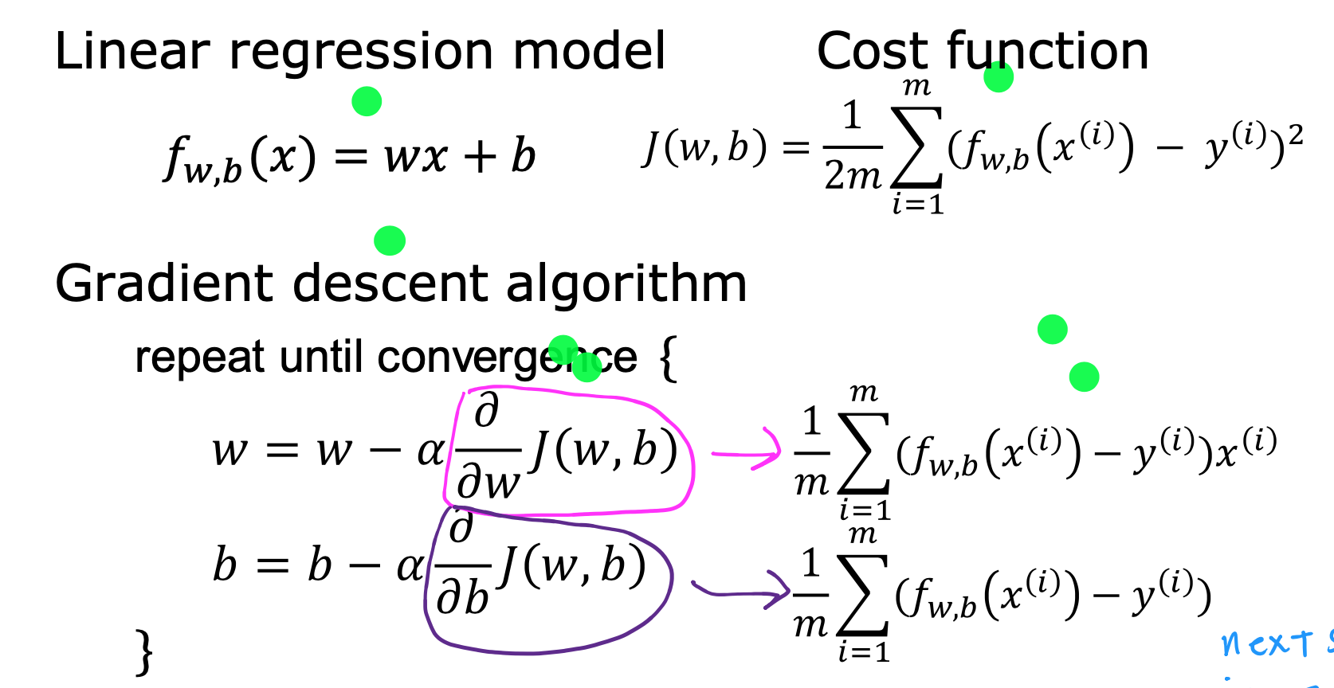
f(x) = wx + b

Slide 20
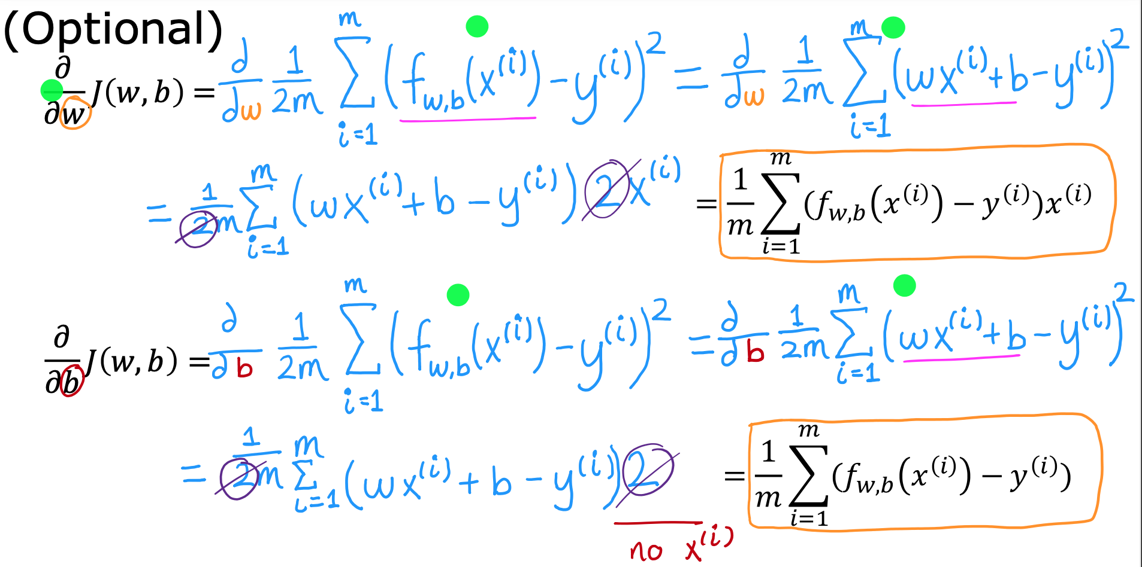

Slide 21
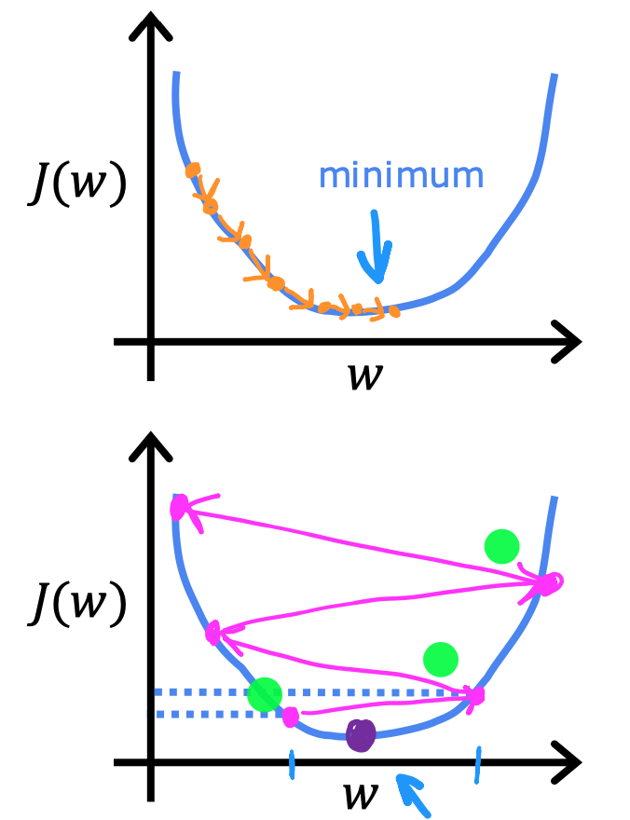
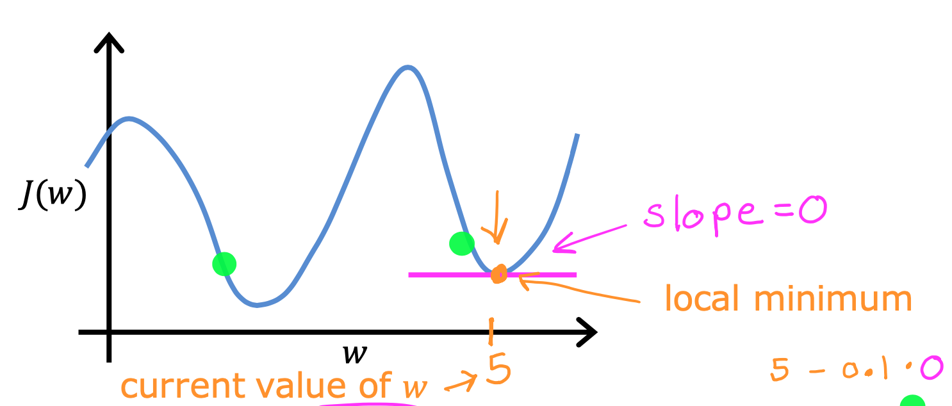
Learning Rate

Slide 22
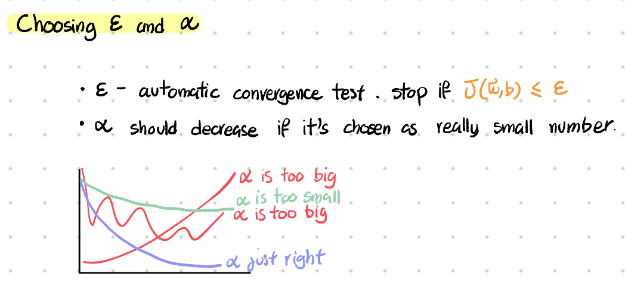
epsilon and learning rate

Slide 23
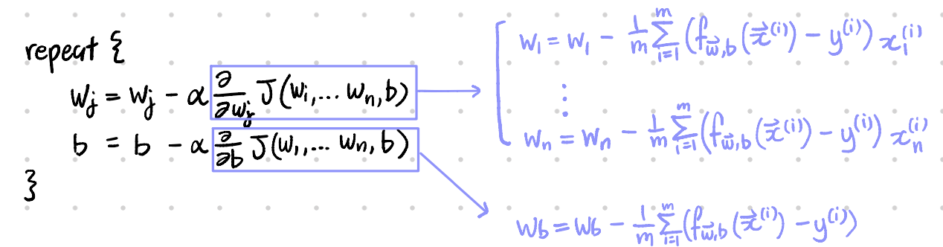
multi features

Slide 24
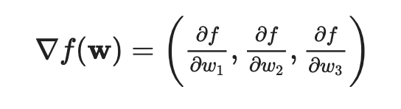
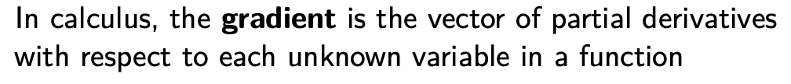
Recap: Gradient

Slide 25
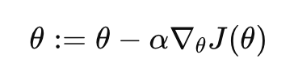
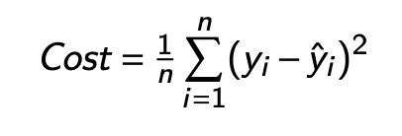
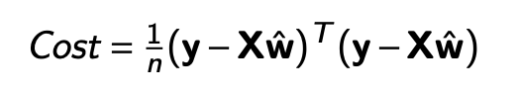
Gradient Descent

Slide 26
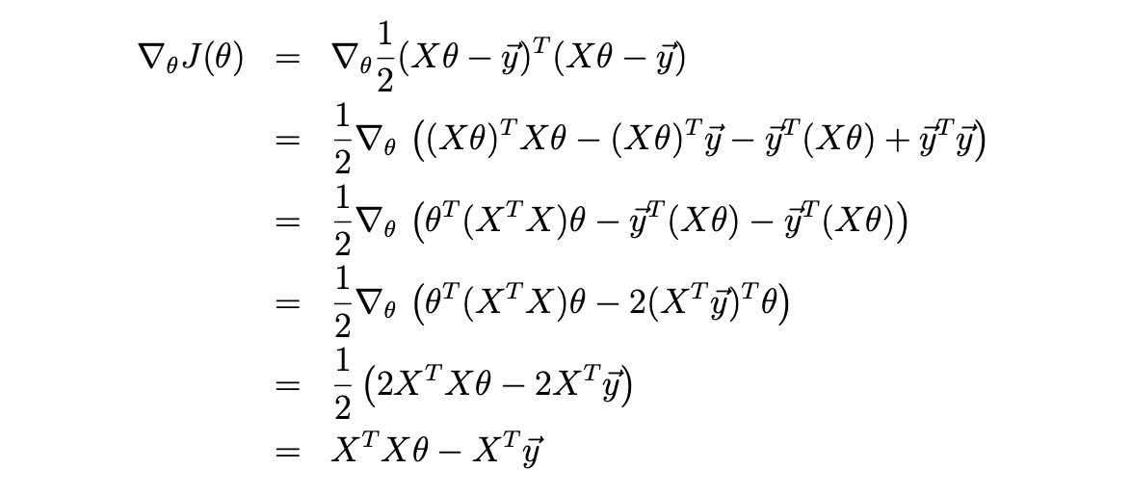
Gradient (Matrix form)
(Stanford CS229)

Slide 27
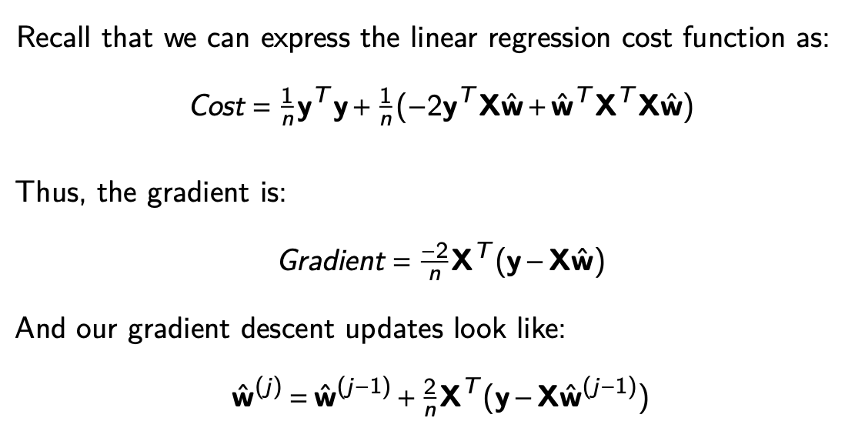
(STA395)

Slide 28
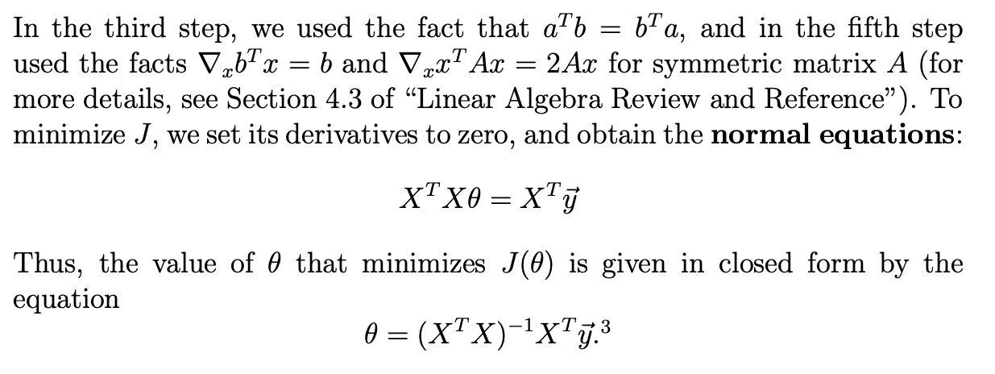
Closed Form

Slide 29
The bias term is implicitly included in the formulation given in the image through the construction of the X matrix and θ vector.
In linear regression, we typically have an input vector x and want to predict a target value y. The model's prediction is given by:
y_hat = θ^T x
Here, x is a feature vector, and θ contains the weights that map the features to the predicted value.
To include the bias term, we augment the feature vector x with an additional constant term (usually 1), and correspondingly add an extra parameter to θ to represent the bias. So if the original feature vector was [x_1, x_2, ..., x_n], the augmented vector becomes:
x_aug = [1, x_1, x_2, ..., x_n]
And θ becomes:
θ_aug = [θ_0, θ_1, θ_2, ..., θ_n]
Where θ_0 represents the bias term.
Now, the prediction is:
y_hat = θ_aug^T x_aug = θ_0 + θ_1x_1 + θ_2x_2 + ... + θ_n*x_n
In the normal equation θ = (X^T X)^-1 X^T y, X is assumed to be the matrix of augmented feature vectors (with the added constant term), and θ is the augmented weight vector (including the bias). So the bias term is inherently part of this formulation, even though it's not explicitly called out.

Slide 30
Feature Scaling

Slide 31
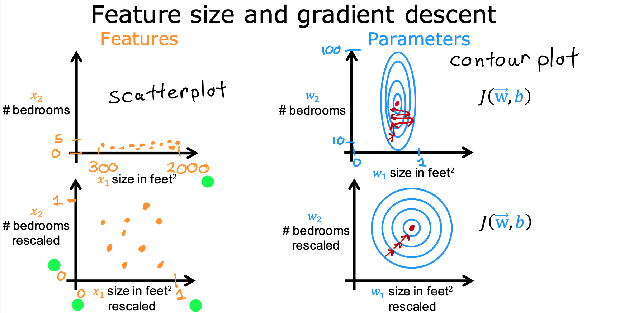
Feature and Cost Function

Slide 32
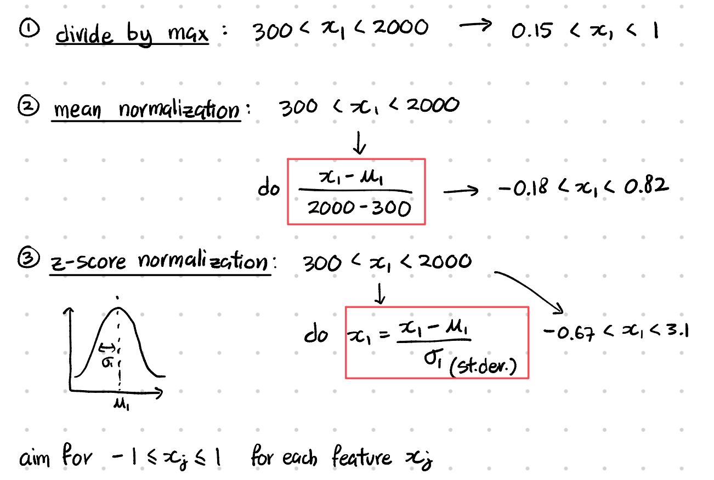
Ways of feature scaling

